Slide 1
A core Course on Modeling
Introduction to Modeling
0LAB0 0LBB0 0LCB0 0LDB0
c.w.a.m.v.overveld@tue.nl
v.a.j.borghuis@tue.nl
P.10

Slide 2
Example of implementing a functional model
The bicycle trip 1: minimize W, maximize s, vary v and t
W=fW*s; kg.m2/s2
fW=c*rho*A*vMPS*vMPS; kg.m/s2
vKMPH=slider(15.0,1,40); km/h
vMPS=vKMPH*mPKM/secPH; m/s
s=vMPS*tSec; m
tH=slider(1,0,5.0); h
tSec=tH*secPH; s
rho=1; kg/m3
A=0.6; m2
c=0.5
secPH=3600; s/h
mPKM=1000; m/km
WMin=paretoMin(paretoHor(W))
sMax=paretoMax(paretoVer(s))
Effort to overcome wind force
Wind force according to formula from ch. 2
Speed under user control in km/h
Speed converted to m/s
Distance s = v * t
Time under user control in h
Time converted to seconds
Density of air
Area of cyclist
Constant according to measurements
To convert hours to seconds
To convert kilometers to meters
Effort should be minimized
Distance should be maximized

Slide 3
Example of implementing a functional model
The bicycle trip 1: minimize W, maximize s, vary v and t
W=fW*s; kg.m2/s2
fW=c*rho*A*vMPS*vMPS; kg.m/s2
vKMPH=slider(15.0,1,40); km/h
vMPS=vKMPH*mPKM/secPH; m/s
s=vMPS*tSec; m
tH=slider(1,0,5.0); h
tSec=tH*secPH; s
rho=1; kg/m3
A=0.6; m2
c=0.5
secPH=3600; s/h
mPKM=1000; m/km
WMin=paretoMin(paretoHor(W))
sMax=paretoMax(paretoVer(s))
Effort to overcome wind force
Wind force according to formula from ch. 2
Speed under user control in km/h
Speed converted to m/s
Distance s = v * t
Time under user control in h
Time converted to seconds
Density of air
Area of cyclist
Constant according to measurements
To convert hours to seconds
To convert kilometers to meters
Effort should be minimized
Distance should be maximized

Slide 4
Example of implementing a functional model
The bicycle trip 1: minimize W, maximize s, vary v and t
W=fW*s; kg.m2/s2
fW=c*rho*A*vMPS*vMPS; kg.m/s2
vKMPH=slider(15.0,1,40); km/h
vMPS=vKMPH*mPKM/secPH; m/s
s=vMPS*tSec; m
tH=slider(1,0,5.0); h
tSec=tH*secPH; s
rho=1; kg/m3
A=0.6; m2
c=0.5
secPH=3600; s/h
mPKM=1000; m/km
WMin=paretoMin(paretoHor(W))
sMax=paretoMax(paretoVer(s))
category I: free choices

Slide 5
Example of implementing a functional model
The bicycle trip 1: minimize W, maximize s, vary v and t
W=fW*s; kg.m2/s2
fW=c*rho*A*vMPS*vMPS; kg.m/s2
vKMPH=slider(15.0,1,40); km/h
vMPS=vKMPH*mPKM/secPH; m/s
s=vMPS*tSec; m
tH=slider(1,0,5.0); h
tSec=tH*secPH; s
rho=1; kg/m3
A=0.6; m2
c=0.5
secPH=3600; s/h
mPKM=1000; m/km
WMin=paretoMin(paretoHor(W))
sMax=paretoMax(paretoVer(s))
category I: free choices
category II: objectives

Slide 6
Example of implementing a functional model
The bicycle trip 1: minimize W, maximize s, vary v and t
W=fW*s; kg.m2/s2
fW=c*rho*A*vMPS*vMPS; kg.m/s2
vKMPH=slider(15.0,1,40); km/h
vMPS=vKMPH*mPKM/secPH; m/s
s=vMPS*tSec; m
tH=slider(1,0,5.0); h
tSec=tH*secPH; s
rho=1; kg/m3
A=0.6; m2
c=0.5
secPH=3600; s/h
mPKM=1000; m/km
WMin=paretoMin(paretoHor(W))
sMax=paretoMax(paretoVer(s))
category I: free choices
category II: objectives
category III: constants from context

Slide 7
Example of implementing a functional model
The bicycle trip 1: minimize W, maximize s, vary v and t
W=fW*s; kg.m2/s2
fW=c*rho*A*vMPS*vMPS; kg.m/s2
vKMPH=slider(15.0,1,40); km/h
vMPS=vKMPH*mPKM/secPH; m/s
s=vMPS*tSec; m
tH=slider(1,0,5.0); h
tSec=tH*secPH; s
rho=1; kg/m3
A=0.6; m2
c=0.5
secPH=3600; s/h
mPKM=1000; m/km
WMin=paretoMin(paretoHor(W))
sMax=paretoMax(paretoVer(s))
category I: free choices
category II: objectives
category III: constants from context
category IV: intermediate quantities

Slide 8
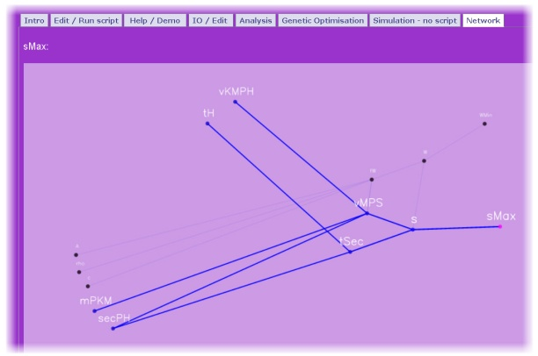
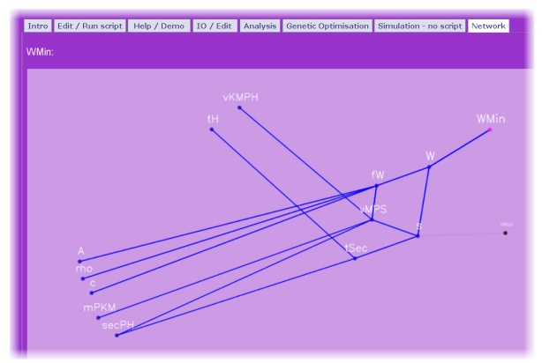
Example of implementing a functional model
The bicycle trip 1: minimize W, maximize s, vary v and t
category I: free choices
category II: objectives
category III: constants from context
category IV: intermediate quantities
The tree, showing the dependencies leading to sMax
The tree, showing the dependencies leading to WMin

Slide 9
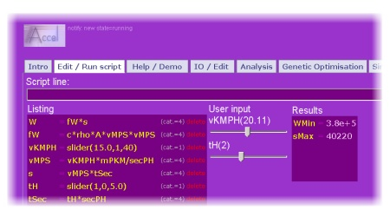
Example of implementing a functional model
The bicycle trip 1: minimize W, maximize s, vary v and t
Cycle with 20.11 km/h for 2 hours,
to travel
40220 m = 40.22 km and
perform 3.8x10⁵ Joules

Slide 10
Example of implementing a functional model
The bicycle trip 2: minimize W, minimize t, vary s and v
W=fW*sM; kg.m2/s2
fW=c*rho*A*vMPS*vMPS; kg.m/s2
vKMPH=slider(15.0,1,40); km/h
vMPS=vKMPH*mPKM/secPH; m/s
sKM=slider(5.0,5.0,120); km
sM=sKM*mPKM; m
tSec=sM/vMPS; s
tH=tSec/secPH; h
rho=1; kg/m3
A=0.6; m2
c=0.5
secPH=3600; s/h
mPKM=1000; m/km
WMin=paretoMin(paretoHor(W));kg.m2/s2
tMin=paretoMin(paretoVer(tH)); h
Effort to overcome wind force
Wind force (formula from ch. 2)
Speed under user control in km/h
Speed converted to m/s
Distance under user control in km
Distance converted to m
Time is distance / speed seconds
Time converted to hours
Density of air
Area of cyclist
Constant according to measurements
To convert hours to seconds
To convert kilometers to meters
Effort should be minimized
Time should be minimized

Slide 11
Example of implementing a functional model
The bicycle trip 2: minimize W, minimize t, vary s and v
To run either of the ACCEL scripts, click on their purple text field or click here:
model 1
model 2

